Slide 1





Get Started With Couchbase
Jessa Ardithya Chriswantoro, Presales Platform
2025
Conﬁdential and Proprietary. Do not distribute without Couchbase consent. © Couchbase 2024. All rights reserved.

Slide 2
What is Couchbase
Data management landscape AI Capabilites
Q&A
Agenda
2

Slide 3



What is Couchbase
7
Confidential and Proprieta
ry. Do not distribute without Couchbase consent. © Couchbase 2024. All rights reserved.
7

Slide 4

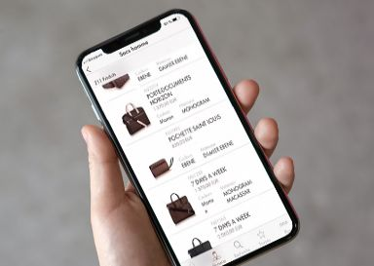

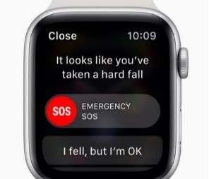

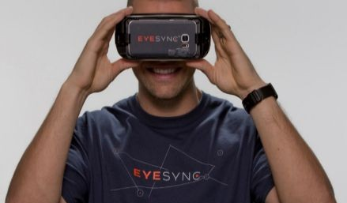



Customers Tell Us: Application Needs Have Changed
Great Experiences
Personalized and responsive
Natural language, AI, real-time
Anywhere and everywhere
Develop Eﬃciently
Simplify and accelerate dev cycle
Tap my skills (SDKs & SQL)
Avoid data sprawl
Deploy Eﬀectively
Support hybrid clouds, Edge, 5G
100% uptime, ﬂexible, global scale
Cost eﬀective
AI-Enabled
Vector and hybrid search
JSON data storage and movement
On-prem, cloud, mobile
Supporting ecosystem
Modern Requirements
Massive data and users
Scale and performance to match
Flexibility for agile development
Web, mobile and IoT experiences
Legacy Requirements
Data control
Storage eﬃciency
ACID transactions
Consistency and integrity
Conﬁdential and Proprietary. Do not distribute without Couchbase consent. © Couchbase 2024. All rights reserved.
4

Slide 5







Couchbase: Cloud Database Platform for Modern Applications
A distributed, SQL++ database-as-a-service for global applications that need high-performance storage, clustering, replication and synchronization
of application data from the cloud, through the edge, to offline-first mobile devices.
CA (HQ), N.
America, EMEA & Asia
More than 30% of Fortune 100
Started 2011
Founded
Offices
Customers
AWS, GCP, Azure,
Infosys, Red Hat
~700 Employees
NASDAQ: BASE
Team
Public
Partners
Confidential and Proprietary. Do not distribute without Couchbase consent. © Couchbase 2022. All rights reserved.
5

Slide 6






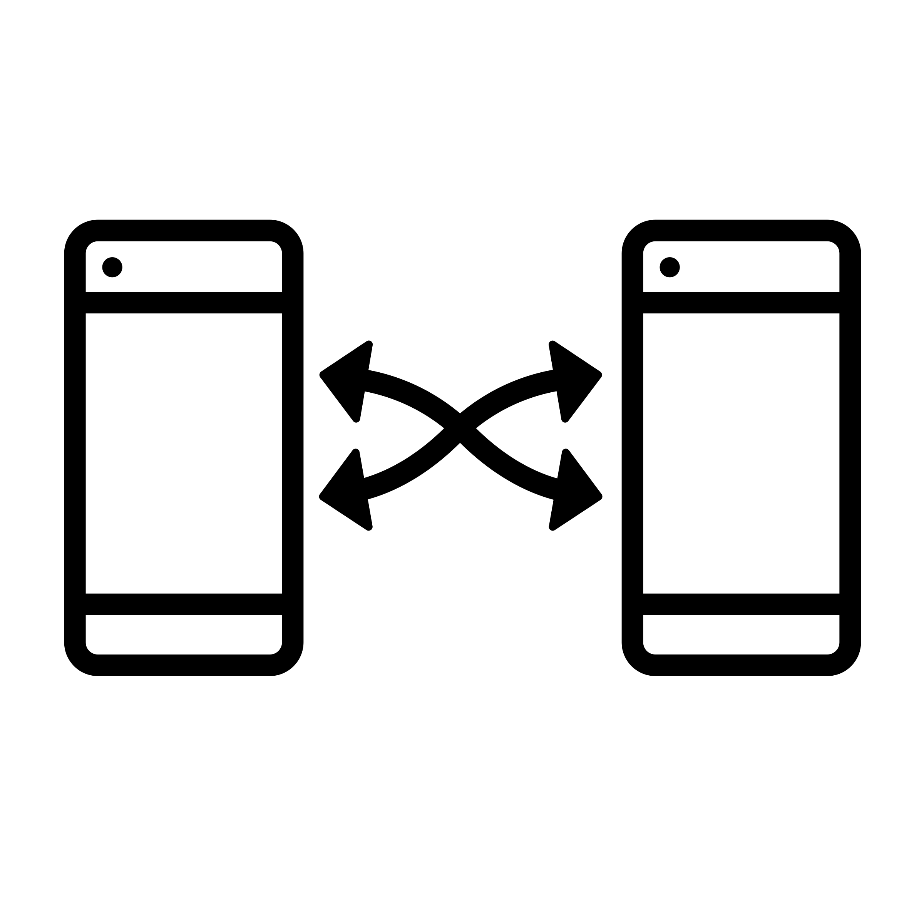


Why Companies Choose Couchbase
Performance
Databases failing demands for millisecond response
Memory-ﬁrst speeds
Innovative Active-Active clustering
Flexibility
Teams lack agility, slowing time to market
Versatile JSON docs, schema with SQL
Vector and broad workload support
Mobile/IoT
Customer have poor on-device experiences
Always-on, advanced sync, vector search
Peer to peer synchronization
Simplify
Excessive resource usage from antiquated designs
Lower cloud and operating costs
Multidimensional resource scaling and optimization
6

Slide 7








Couchbase Capella: Key Capabilities
Fully Managed
Enterprise-Grade Performance
Development Flexibility
High Availability
Automated Scaling In/Out & Up/Down
Single Pane for Multi-cluster, Multi-region
Self Monitoring, Self Healing
Security Peace of Mind
Notes:
Talking points: (fairly quick on this slide - first row has mainly been covered and second row will be in next slides)
Here you can see some of the key way that Capella benefits customers

Slide 8
Our use case
7
Confidential and Proprieta
ry. Do not distribute without Couchbase consent. © Couchbase 2024. All rights reserved.
7

Slide 9

Linkedin Use Case
Caching – Speeding up Legacy Systems
Key Aspects
Easy pathway for customers to begin with Couchbase without need to do a full replacement at the start
Delivers quick wins for customer: performance and reliability gains
Most common entry point for new customers
- we lots of big and successful customer examples
Challenge
Inability to scale reads on Oracle
was bringing down back-end systems
Needed to balance performance with built-in replication and cluster expansion
Solution
Achieved tremendous performance at scale, averaging
<4ms latency for over 2.5 billion items
All in-memory storage is done by Couchbase, powering 10+ million queries per second across all servers and clusters

Slide 10






Industry & Innovation Leaders
Global fraud detection and prevention
Oﬄine-ﬁrst applications for edge-based mobile devices
High performance caching for social network
Real time user updates for communication application
3B+
payment accounts protected
65%
of world’s card accounts
270
aircrafts
pre-ﬂight checks
158
destinations served
10M+
requests per second
800M+
global users
15B
calling and messaging events
1B
users worldwide
Conﬁdential and Proprietary. Do not distribute without Couchbase consent. © Couchbase 2024. All rights reserved.
9

Slide 11






















































Proven Enterprise Solution Chosen by Industry Leaders
Retail &
E-Commerce
Travel & Hospitality
Financial Services
Technology & Business Services
Telecom
Media & Entertainment
Gaming
Manufacturing & Utilities
Conﬁdential and Proprietary. Do not distribute without Couchbase consent. © Couchbase 2024. All rights reserved.
11

Slide 12
Data Management Landscape
12
Confidential and Proprieta
ry. Do not distribute without Couchbase consent. © Couchbase 2022. All rights reserved.
12

Slide 13
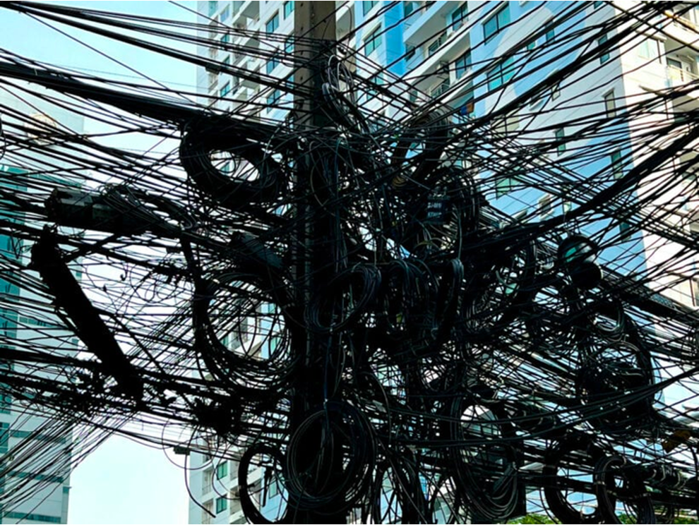




















Reality: Data Sprawl & Management Challenges
Applications and Microservices
Mobile/Edge Apps
Cache
NoSQL Database
Relational
Database
Query tools
Geo
Replication
Full Text Search
Eventing
Analytics
Mobile
Infrastructure layers
Notes:
Key points:
As applications and requirements grow, things look more like this. Where app requirements use a variety of data management technologies
Transition: And creating and supporting all those data management technologies is costly.

Slide 14




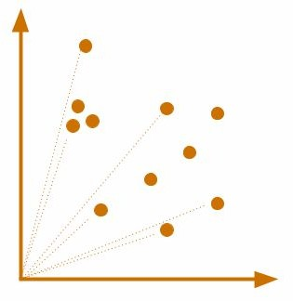












Couchbase’s Diﬀerentiated Architecture
Fast, Aﬀordable, Versatile, and Easy as SQL
AI-powered Applications
Mobile/Edge AI Apps
Key ^{JSON} JSON iQ JSON Key-Value SQL query with Full-Text & Real-time Graph Time Eventing Mobile Docs Access AI assist Vector Search Analytics Traversal Series & Streaming Database JSON JSON JSON Integrated Active-Active Cluster Magma ACID Workload Columnar Geo-Replication Cache Clustering Map Storage Transactions Tuning (MDS) Storage & Sync
Enterprise-grade Security
Data Access
Services
Performance Foundation
Enterprise Deployments
Public Cloud
Cloud Edge
On Prem
IoT edge, devices
Conﬁdential and Proprietary. Do not distribute without Couchbase consent. © Couchbase 2024. All rights reserved.
14

Slide 15
How Couchbase Helps Our Customers
20
Confidential and Proprieta
ry. Do not distribute without Couchbase consent. © Couchbase 2022. All rights reserved.
20

Slide 16

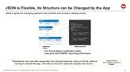
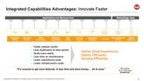
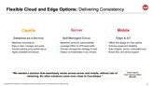
Couchbase is Flexible
Flexible Familiar Fast Affordable
Confidential and Proprietary. Do not distribute without Couchbase consent. © Couchbase 2023. All rights reserved.

Slide 17

JSON is Flexible, its Structure can be Changed by the App
JSON is great for changing dynamic user profiles and complex catalog entries
USERS
{
ID
First
Last
“UserID”: “1”,
“firstName”:”Jeffrey”, “lastName”: “Mackay”,
“skills”: [”SQL”, “JavaScript”, “NoSQL”]
“experience”: [
{
“role”: “Solutions Architect”, “company”: “AppMax Inc”,
},
{
“role”: “Solutions Engineer”, “company”: “Couchbase”,
}
]
}
1
Jeffrey
Mackay
USER_SKILLS
UserID Skill Name
1 SQL
1 JavaScript
1 NoSQL
1
USER_EXPERIENCE
ID Role
Company
1
Solutions Architect
AppMax Inc
1
Solutions Engineer
Couchbase
Relational JSON Document
Tables
Doc format aligns to application needs
Less joins than RDBMS, improving performance
“Developers can now take ownership and change business rules on the fly, without having to rebuild the app. This lets us focus on what we actually have to do.”
Joaquim Olivera
Head of Mobile Development
Ryanair
Confidential and Proprietary. Do not distribute without Couchbase consent. © Couchbase 2023. All rights reserved.

Slide 18








Integrated Capabilities Advantages: Innovate Faster
Applications and Microservices
Mobile/Edge Apps
SQ L
Integrated Cache |  | Key-Value Access | JSON Documents | Relational Capabilities |  | SQL Query |  | Full Text Search |  | Operational Analytics |  | Eventing |  | Geo-Replication & Sync |  | Mobile Database
Faster release cycles
Less duplication & data sprawl
Scale more easily
Less time on maintenance
Lower operational costs
Lower infrastructure costs
Deliver Great Experiences Deploy Efficiently Develop Efficiently
“It’s unusual to get more features, in less time and save money,… all at once.”
Phil Lupercio
VP of Technology
BroadJump
Confidential and Proprietary. Do not distribute without Couchbase consent. © Couchbase 2023. All rights reserved.
23

Slide 19
Flexible Cloud and Edge Options: Delivering Consistency
Capella
Server
Mobile
Database-as-a-Service
Maximize convenience
Easy to start, manage, and scale
Industry leading price-performance
Highly available and secure
Self-Managed-Cloud
Maximize control & customizability
Leverage DBA’s & OPS team skills
Choose management strategy & tools
Deploy via Kubernetes if you choose
Edge & IoT
Offline first design for max uptime
Extreme speed and reliability
Data integrity: secure, automated sync
Broad SQL and device support
“We wanted a solution that seamlessly works across server and mobile, without lots of retraining. No other solutions came even close to Couchbase.”
Aviram Agmon
Chief Technical Officer Maccabi
Confidential and Proprietary. Do not distribute without Couchbase consent. © Couchbase 2023. All rights reserved.

Slide 20
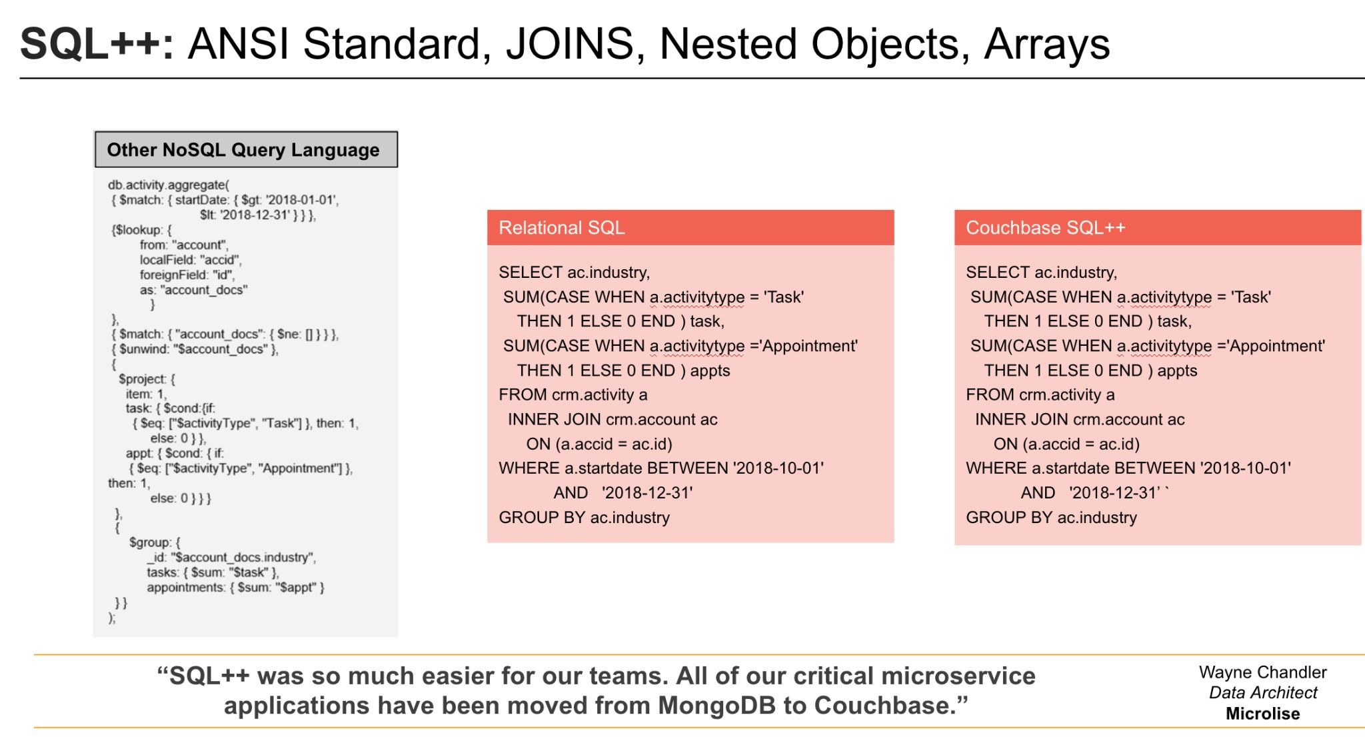
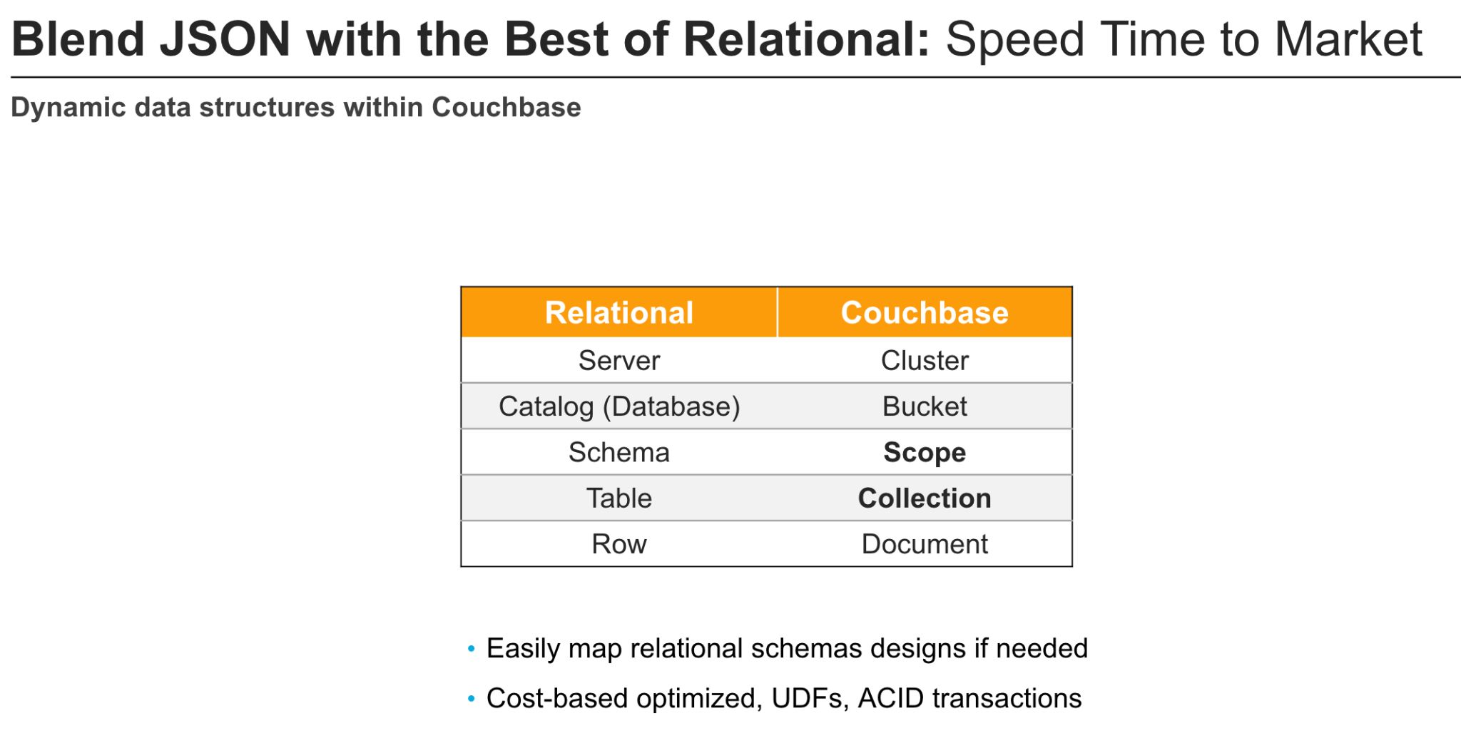
Couchbase is Familiar
Flexible Familiar Fast Affordable
Confidential and Proprietary. Do not distribute without Couchbase consent. © Couchbase 2023. All rights reserved.

Slide 21
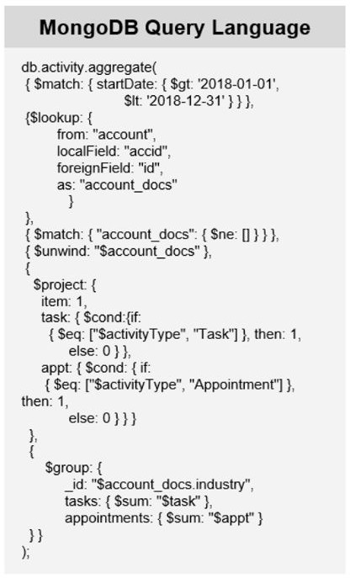
SQL++: ANSI Standard, JOINS, Nested Objects, Arrays
Other NoSQL Query Language
Relational SQL
Couchbase SQL++
SELECT ac.industry,
SUM(CASE WHEN a.activitytype = 'Task' THEN 1 ELSE 0 END ) task,
SUM(CASE WHEN a.activitytype ='Appointment' THEN 1 ELSE 0 END ) appts
FROM crm.activity a
INNER JOIN crm.account ac ON (a.accid = ac.id)
WHERE a.startdate BETWEEN '2018-10-01' AND '2018-12-31'
GROUP BY ac.industry
SELECT ac.industry,
SUM(CASE WHEN a.activitytype = 'Task' THEN 1 ELSE 0 END ) task,
SUM(CASE WHEN a.activitytype ='Appointment' THEN 1 ELSE 0 END ) appts
FROM crm.activity a
INNER JOIN crm.account ac ON (a.accid = ac.id)
WHERE a.startdate BETWEEN '2018-10-01' AND '2018-12-31’ `
GROUP BY ac.industry
“SQL++ was so much easier for our teams. All of our critical microservice applications have been moved from MongoDB to Couchbase.”
Wayne Chandler Data Architect Microlise
Confidential and Proprietary. Do not distribute without Couchbase consent. © Couchbase 2023. All rights reserved.

Slide 22
Blend JSON with the Best of Relational: Speed Time to Market
Dynamic data structures within Couchbase
Relational | Couchbase
Server | Cluster
Catalog (Database) | Bucket
Schema | Scope
Table | Collection
Row | Document
Easily map relational schemas designs if needed
Cost-based optimized, UDFs, ACID transactions
Confidential and Proprietary. Do not distribute without Couchbase consent. © Couchbase 2023. All rights reserved.

Slide 23

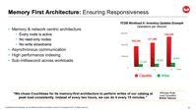
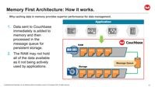
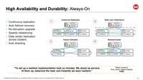
Couchbase is Fast
Flexible Familiar Fast Affordable
Confidential and Proprietary. Do not distribute without Couchbase consent. © Couchbase 2023. All rights reserved.

Slide 24
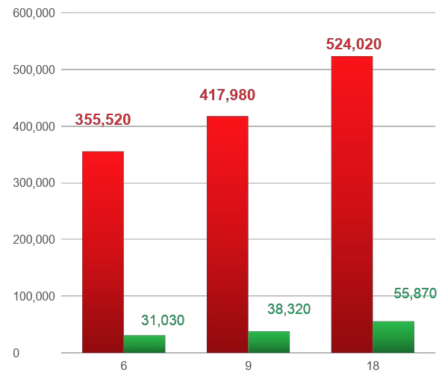
Memory First Architecture: Ensuring Responsiveness
YCSB Workload A: Inventory Updates Example
Operations per Second
Memory & network centric architecture
Every node is active
No read-only nodes
No write slowdowns
Asynchronous communication
High performance indexing
Sub-millisecond across workloads
Nodes
Capella
Atlas
“We chose Couchbase for its memory-first architecture to perform writes of our catalog at peak load consistently. Instead of every two hours, we can do it every 15 minutes.”
Mritunjay Singh Lead Consultant British Telecom
Confidential and Proprietary. Do not distribute without Couchbase consent. © Couchbase 2023. All rights reserved.

Slide 25
















Memory First Architecture: How it works.
Why caching data in memory provides superior performance for data management.
Application
Data sent to Couchbase immediately is added to memory and then processed in the message queue for persistent storage.
The RAM may not hold all of the data available as it not being actively used by applications.
RAM
DOC1 DOC2 DOC3 DOC4
Message Queue
Storage
DOC1 DOC2 DOC3 DOC4 DOC5
Confidential and Proprietary. Do not distribute without Couchbase consent. © Couchbase 2023. All rights reserved.

Slide 26





Low Latency Everywhere: Globally, to the Edge, and in Device
Geo-Replication Service
Sync Service
Active DC
Active DC
Subset data
All data
Standby DC
Data Center
Gateway
All data
Low latency to the Edge
Peer–to-peer syncing
“There are many key factors for choosing Couchbase: scalability, high availability, and geo-replication to name a few.”
Krishnan Venkatasubramanian
Head of IT Architecture
Sky
Confidential and Proprietary. Do not distribute without Couchbase consent. © Couchbase 2023. All rights reserved.

Slide 27


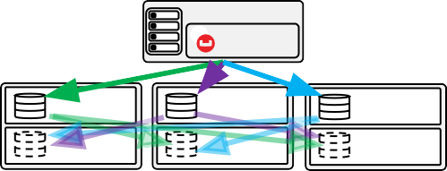
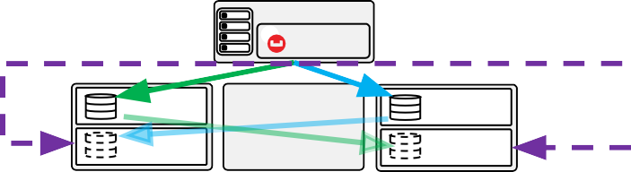
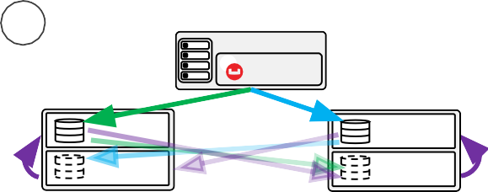
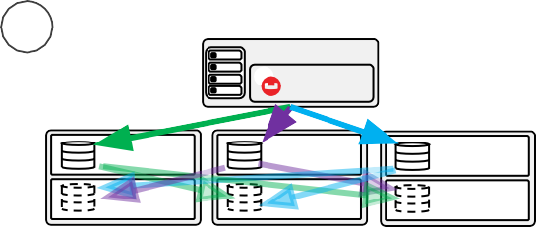
High Availability and Durability: Always-On
Continuous replication
Auto failover recovery
No-disruption upgrade
Speedy rebalancing
Data center replication across clusters
Auto sharding
1
Continuous Replication
2
Node Loss: Failed Server
App Server
Client library cluster map
App Server
Client library cluster map
ACTIVE
ACTIVE
ACTIVE
ACTIVE
ACTIVE
REPLICA
REPLICA
REPLICA
REPLICA
REPLICA
3
Failover Activation
4
Restored Cluster
App Server
Client library cluster map
App Server
Client library cluster map
ACTIVE
ACTIVE
ACTIVE
ACTIVE
ACTIVE
REPLICA
REPLICA
REPLICA
REPLICA
REPLICA
“To set up a resilient implementation took us minutes. We stood up servers, lit them up, balanced the load, and instantly we were resilient.”
Robert Lawrence
Prod. Owner, Digital Catalysts
PG&E
Confidential and Proprietary. Do not distribute without Couchbase consent. © Couchbase 2023. All rights reserved.

Slide 28

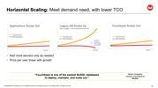

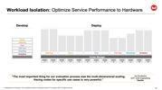
Couchbase is Affordable
Flexible Familiar Fast Affordable
Confidential and Proprietary. Do not distribute without Couchbase consent. © Couchbase 2023. All rights reserved.

Slide 29
Workload Isolation: Optimize Service Performance to Hardware
Develop
Deploy
Query
Indexing
Data
Full Text
Eventing
Analytics
Indexing
Query
Data
Full Text
Eventing
Analytics
Cluster Manager
NODE 1 | NODE 2 | NODE 3 | NODE 4 | NODE 5 | NODE 6 | NODE 7 | NODE 8 | NODE 9 | NODE 10 | NODE 11 | NODE 12 | NODE 13
“The most important thing for our evaluation process was the multi-dimensional scaling.
Having nodes for specific use cases is very powerful.”
Jay Duraisamy
SVP, USIS Engineering
Equifax
Confidential and Proprietary. Do not distribute without Couchbase consent. © Couchbase 2023. All rights reserved.

Slide 30




Bringing AI capabilities to applications

Slide 31
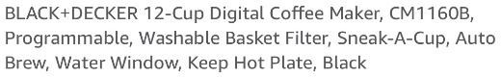

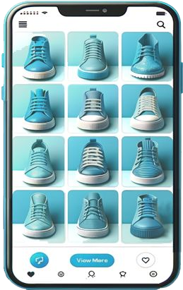

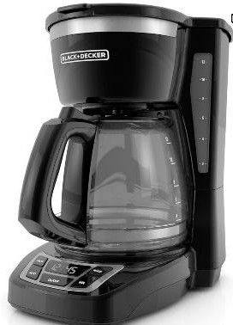
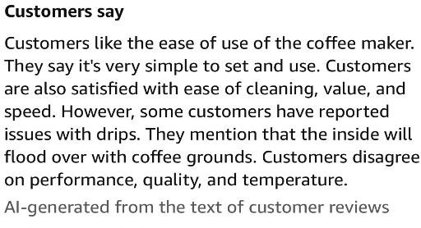

Overview | Use Cases
Content Generation
Data Analysis: Classiﬁcation / Anomalies
Advanced Semantic / Hybrid Search
AI-powered Chatbots and Applications
Conﬁdential and Proprietary. Do not distribute without Couchbase consent. © Couchbase 2024. All rights reserved.
40

Slide 32
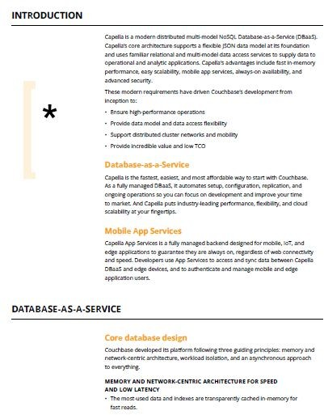




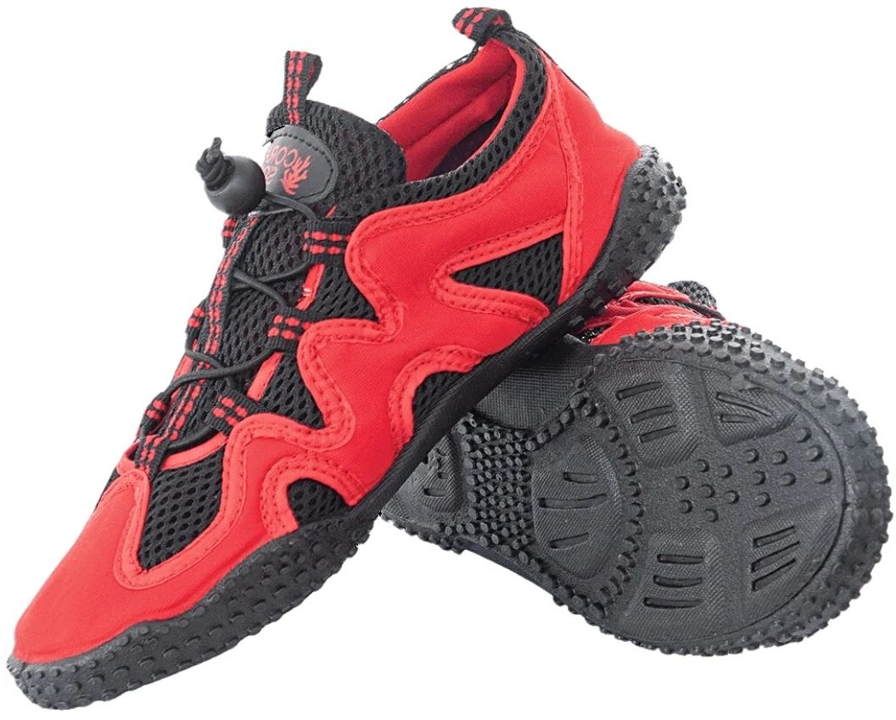

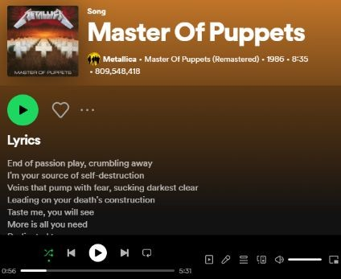





Overview | Introduction to Couchbase Vector Search
[0.9229, 0.7824, 0.194, 0.0402,
0.206, 0.4446, 0.5875, 0.4214,
0.2371, 0.4038, 0.9229, 0.7824,
0.194, 0.0402, 0.206, 0.4446, 0.5875,
0.4214, … , 0.4038]
JSON Storage Indexing and Queries
{
"type": “shoes", "productId": "CP123456", "category": “Gym Shoes", "name": “Beach Sneakers", "brand": “Ultimate Surf",
"description": “The ultimate companion for beach adventurers, designed to …",
“descVector": [0.0509, 0.8862,…]
}
Search Service
text
Embedding Models
Vector Indexing
[0.0509, 0.8862, 0.179, 0.4116,
0.5995, 0.769, 0.5282, 0.8079,
0.0468, 0.272, 0.0509, 0.8862, 0.179,
0.4116, 0.5995, 0.769, 0.5282,
0.8079, … , 0.272]
image
Query Processing
[0.3819, 0.1375, 0.0828, 0.0856,
0.9081, 0.1556, 0.6251, 0.7356,
0.2964, 0.2198, 0.3819, 0.1375,
0.0828, 0.0856, 0.9081, 0.1556,
0.6251, 0.7356, … , 0.2198]
audio
Objects Vector Embeddings
Generate Vector Embeddings via Embedding Models
Store, Index and Query Vector Embeddings with Couchbase
What is a Vector Embedding
A array of ﬂoating point numbers that represent the meaning of an object (text, image, audio, …)
Vector Embeddings storage in Couchbase
Vectors are stored as a ﬁeld in your JSON documents.
A document can have multiple Vectors, each of size <=2048*.
How are Vector Embeddings generated
Embeddings models are algorithms trained to turn objects into vectors embeddings
Vector Indexing and Queries in Couchbase
The Search Service provides Vector Indexing in near real-time and Querying Processing for similarity and semantic search.
Conﬁdential and Proprietary. Do not distribute without Couchbase consent. © Couchbase 2024. All rights reserved.
(*) Subject to increase soon
41

Slide 33





Couchbase: Architected for AI-based Applications
No Separate Vector Database Needed
Simplify | Lower latency | Save
Proven Speed and Flexibility
In-memory architecture | Flexible JSON | Powering Indexing
Vector Across our Products
On-prem | Cloud | Oﬄine mobile
Broad Platform Capabilities
Proﬁles & Catalogs | Vector Search |Text Search | Graph | Real-time Analytics| Powerful SQL
Ecosystem Integrations
LangChain | LlamaIndex
Conﬁdential and Proprietary. Do not distribute without Couchbase consent. © Couchbase 2024. All rights reserved.
33

Slide 34
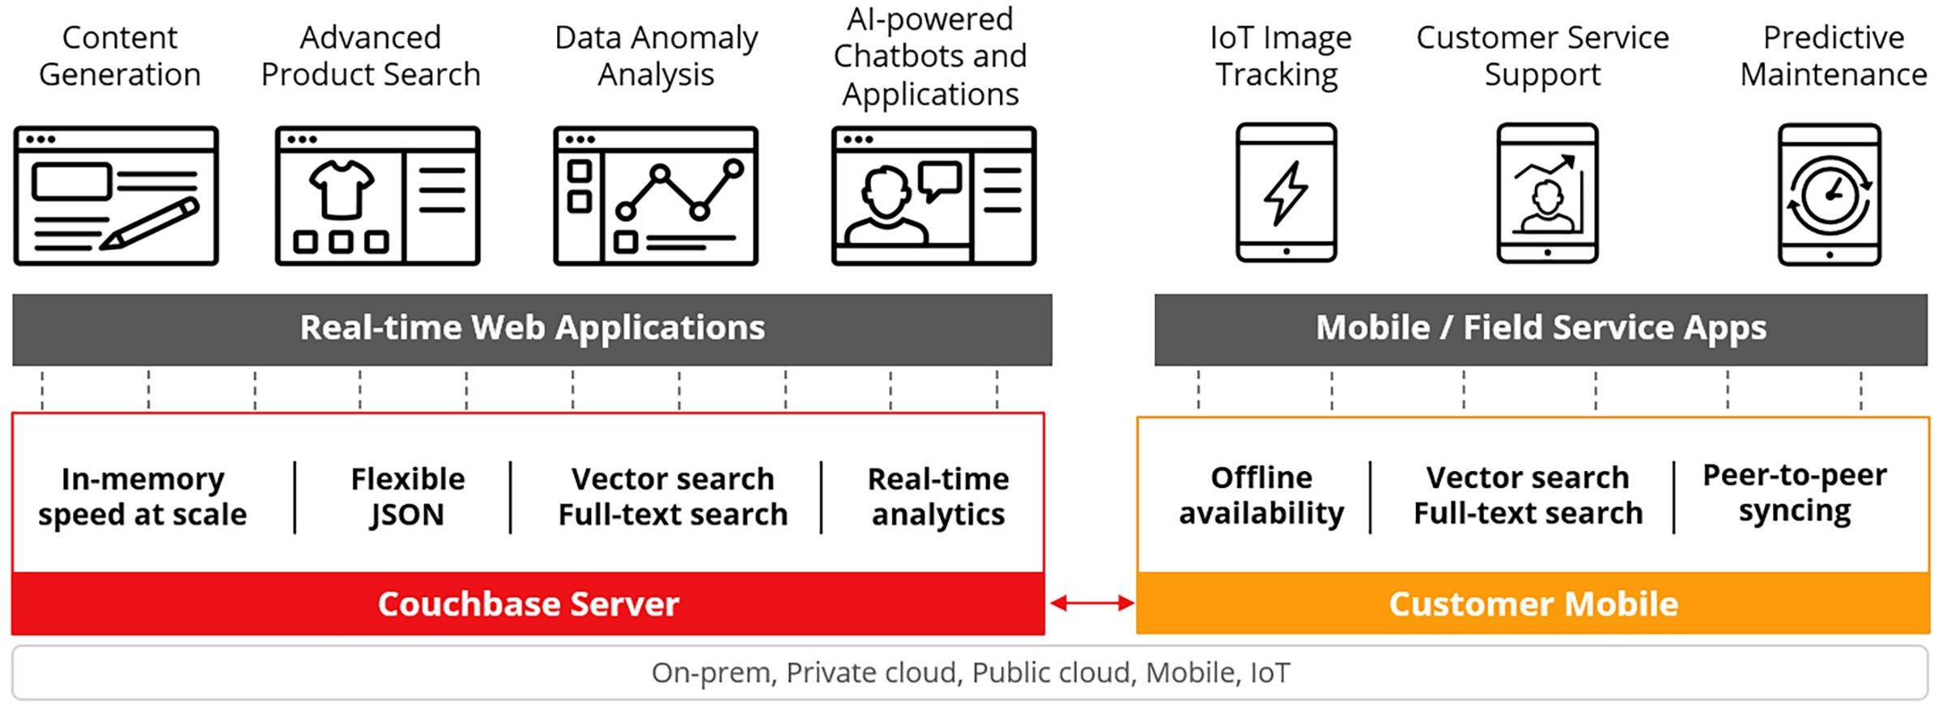
Vector Across our Products
First in the industry to announce support for all 3 deployments: Cloud, on-prem, mobile
Conﬁdential and Proprietary. Do not distribute without Couchbase consent. © Couchbase 2024. All rights reserved.
34

Slide 35
Thank you!
44
Confidential and Proprieta
ry. Do not distribute without Couchbase consent. © Couchbase 2024. All rights reserved.
44

